Slide 1
Hello Django
A two-day hands on workshop on Django

Slide 2

Final app Demo

Slide 3
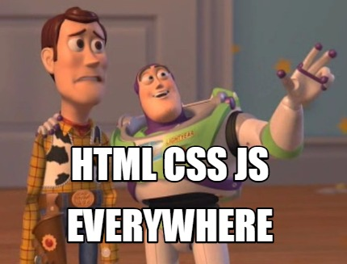
Why?
Easy (visual medium).
It’s everywhere.
++opportunities;
Hackathons.
Freelance.
Projects.
Goes on…

Slide 4

Why not X?
A good starting point (high level).
Easy.
Secure.
Batteries-included (feature packed).
Less dev time.
Does it really matter?

Slide 5
Concept matters!

Slide 6
Questions?

Slide 7




Practical Python!

Slide 8
Questions?

Slide 9
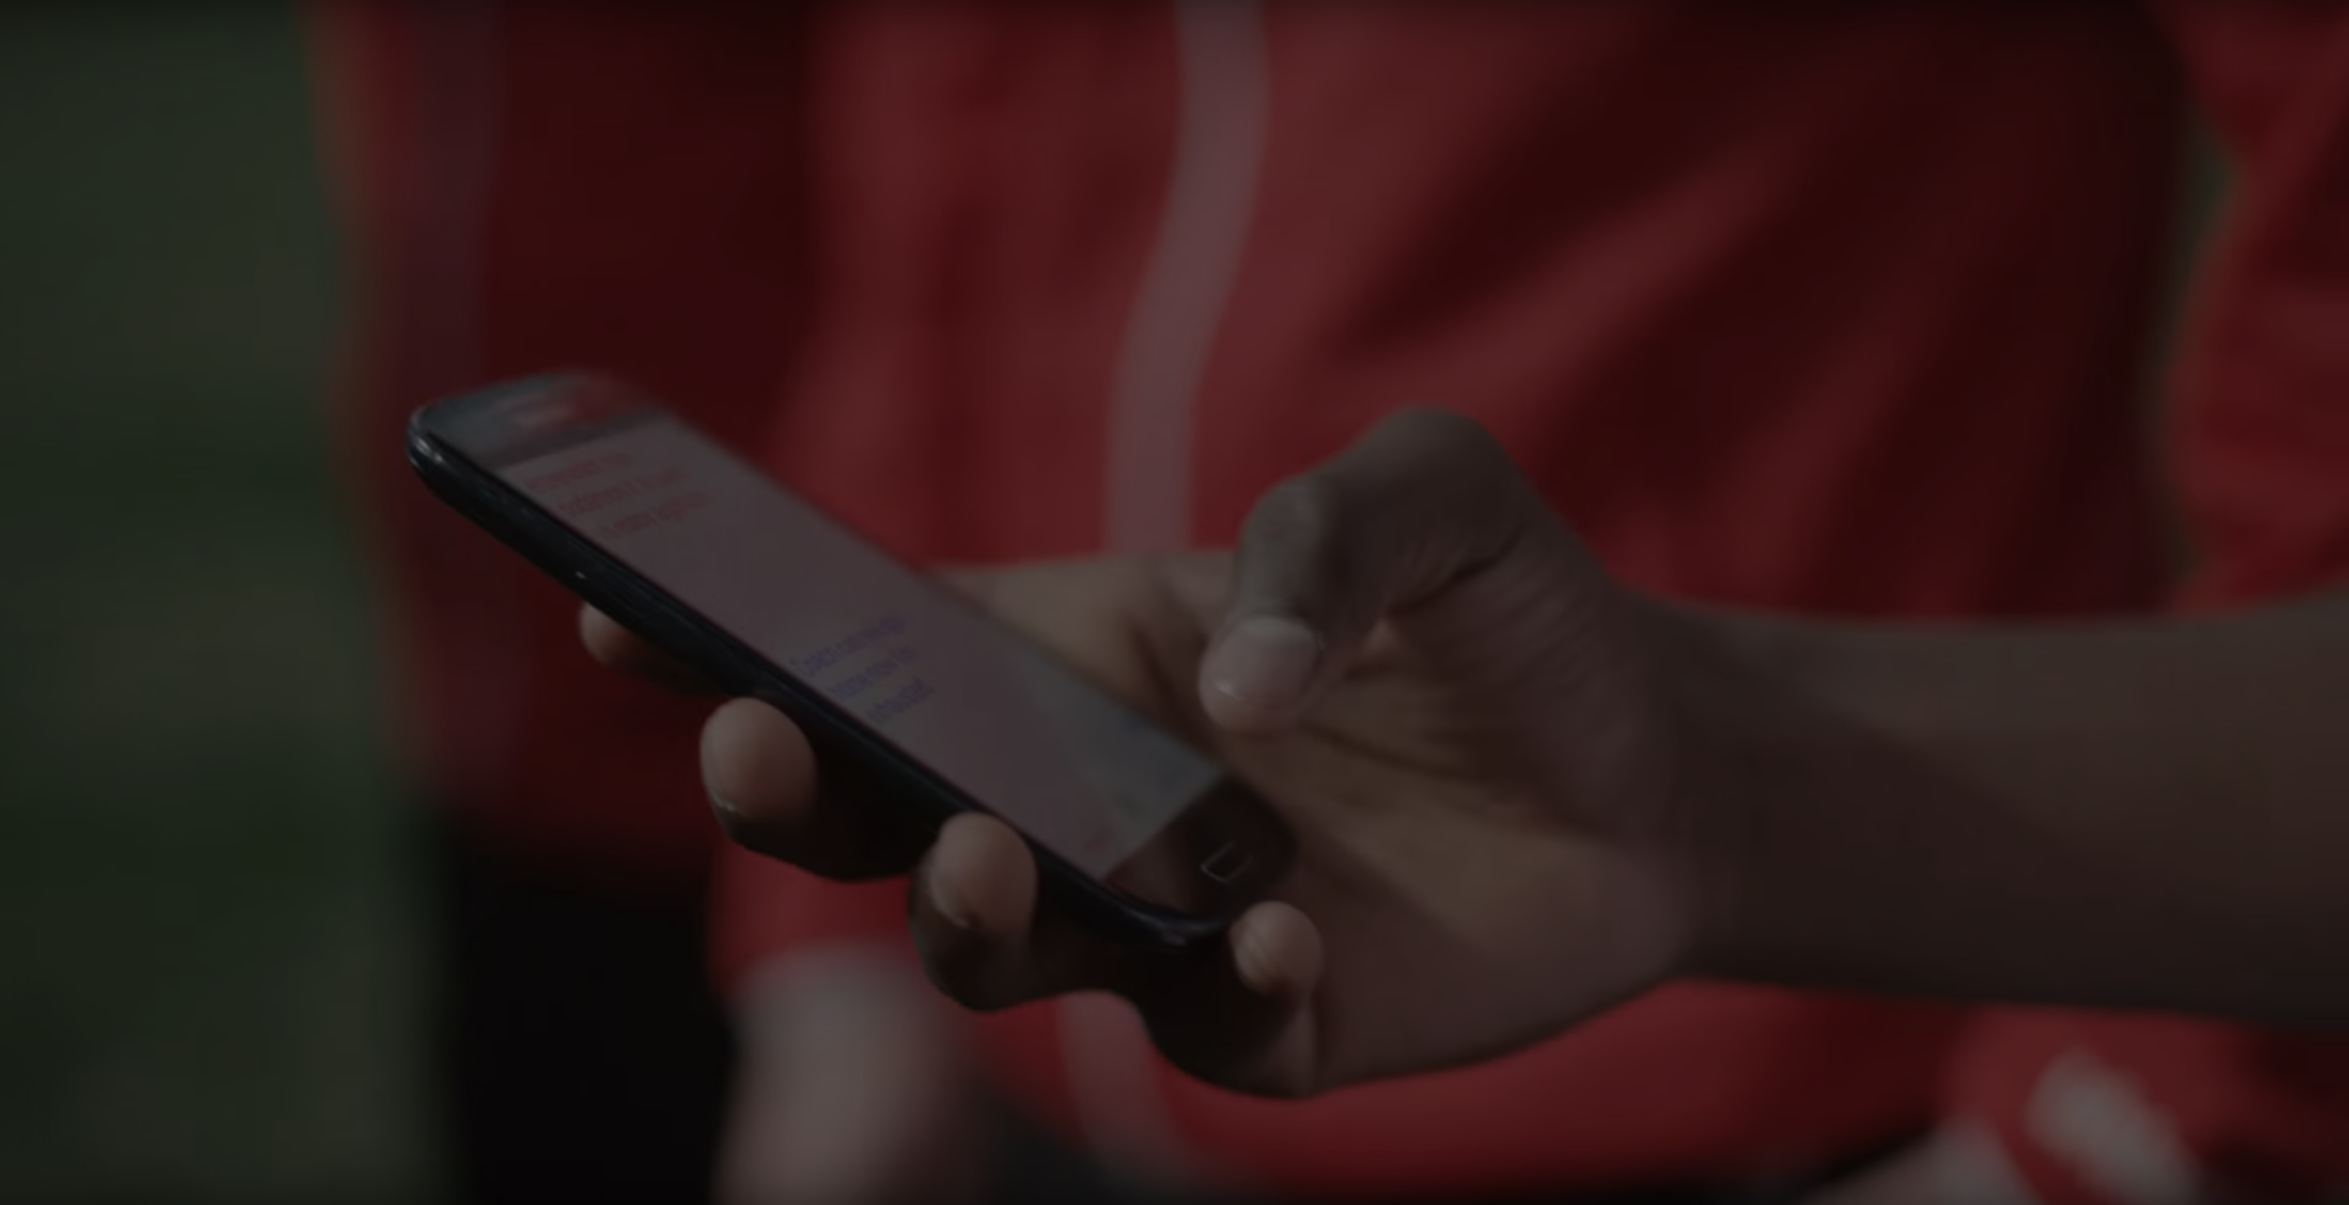
Client-server
Communication (HTTP)

Slide 10
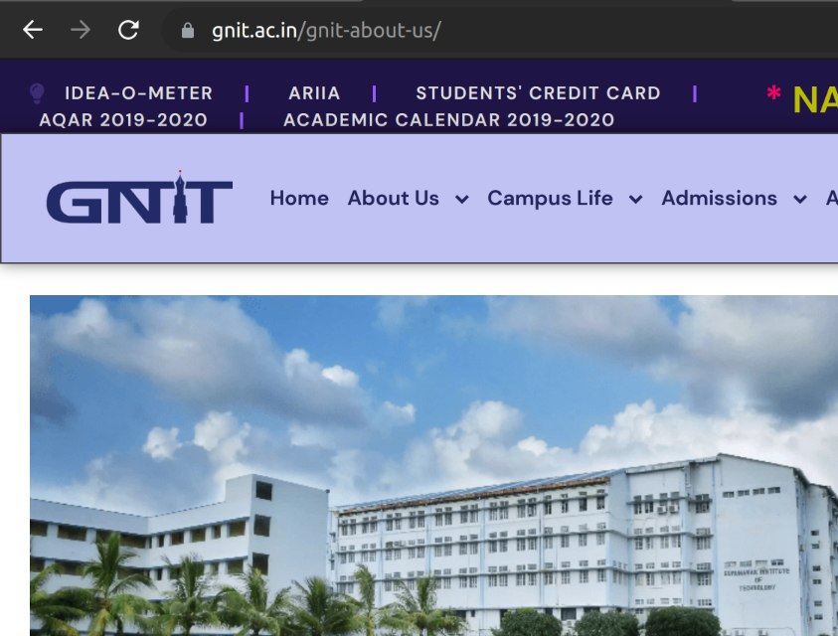
:authority: gnit.ac.in
:method: GET
:path: /gnit-about-us/
:scheme: https
accept: text/html,...,image/webp,image/apng,...
accept-encoding: gzip, deflate, br
accept-language: en-GB,en-US;...
cookie: PHPSESSID=b70a1cd40dee1ef9f610f1a780494a21
...
sec-ch-ua: "Not_A Brand";v="99", "Google Chrome";v="109", "Chromium";v="109"
sec-ch-ua-mobile: ?0
sec-ch-ua-platform: "Linux"
...
user-agent: Mozilla/5.0 (X11; Linux x86_64) AppleWebKit/537.36 (KHTML, like Gecko) Chrome/109.0.0.0 Safari/537.36
...
status: 200 (OK)
content-encoding: gzip
content-type: text/html; charset=UTF-8
...
wpo-cache-status: cached
server: Apache ...
x-powered-by: PHP/7.3.33 + the HTML page…

Slide 11
Break

Slide 12
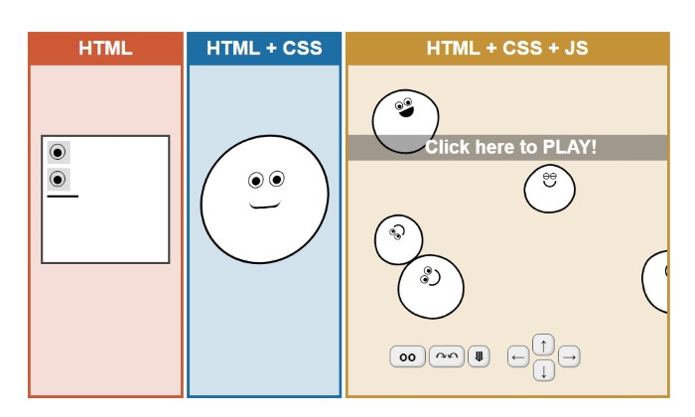
Tip
JavaScript != Java

Slide 13
1. Practical html, css js (pattern) + post and cookies (auth)

Slide 14
Questions?

Slide 15


[
{
"id": 1,
"title": "title 1",
"url": "https://via.placeholder.com…,
"thumbnailUrl": "https://via.placeholder.com…
},
{
"id": 2,
"title": "title 2",
"url": "https://via.placeholder.com…,
"thumbnailUrl": "https://via.placeholder.com…
}
]
Modern web (web 2.0)
title 1
title 2
Rendered HTML using a Front End framework (or a mobile app widget)
JSON from server

Slide 16
Thank you

